Slide 1
Stroke Prediction
Machine Learning-I
Shikha Sharma
Aron Rock
Sanjana Godolkar

Slide 2
Introduction
Stroke is a life-threatening condition that disrupts blood flow to the brain, leading to a high risk of disability and death
Our project aims to utilize machine learning techniques to predict stroke risk based on modifiable risk factors such as hypertension, diabetes, and lifestyle factors. By analyzing large datasets, we aim to develop a personalized application that delivers stroke risk warnings and tailored messages for lifestyle modifications. Ultimately, this approach has the potential to reduce the impact of stroke on individuals and healthcare systems worldwide.
Notes:
Stroke is a life-threatening condition that disrupts blood flow to the brain, leading to a high risk of disability and death. According to the World Health Organization, stroke is the leading cause of death and disability worldwide. Early recognition of warning signs and prompt medical attention can reduce the severity of the condition.
Our results show that the models developed in this investigation are more reliable than previous studies and provide promising accuracy for predicting strokes. These models have the potential to enhance early intervention strategies, promote healthier lifestyles, and ultimately save lives by reducing the impact of strokes on individuals and communities worldwide.

Slide 3
Dataset Description
Source: Kaggle ("healthcare-dataset-stroke-data")
5,110 observations with 12 attributes
Attributes: ID, Gender, Age, Hypertension, Heart Disease, Ever Married, Work Type, Residence Type, Avg. Glucose Level, BMI, Smoking Status, Stroke
Imbalanced dataset:
Stroke cases: 249
Non-stroke cases: 4,861

Slide 4
Data Preprocessing
Cleaning and preparing data for model development
Excluding 'id' column
Handling missing values: Filling null values in 'BMI' column with mean
Label encoding for categorical variables
Balancing the dataset using the SMOTE technique

Slide 5
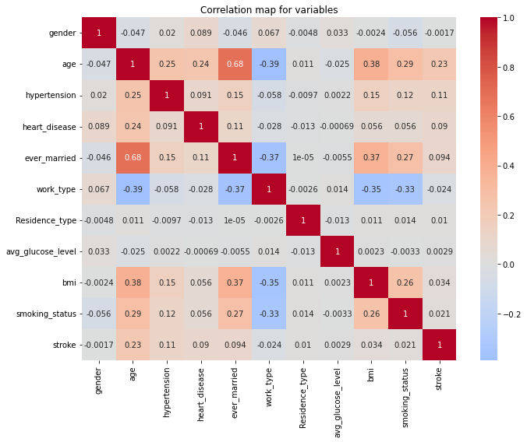
Heat Map

Slide 6
Feature Reduction
Dropped the following features:
‘gender’ , ’ever_married’ , ‘work_type’ , ‘Residence_type’ , ‘avg_glucose_level’ , ‘bmi’ , ‘smoking_status’
Keeping the following features:
‘age’ , ‘hypertension’, ‘heart_disease’

Slide 7
SMOTE
SMOTE (Synthetic Minority Over-sampling Technique) is an oversampling technique used in machine learning to handle imbalanced datasets.
It creates synthetic examples of the minority class by selecting the nearest neighbors and changing them to generate new samples.
SMOTE helps to balance the class distribution, allowing for better performance of machine learning models and reducing the risk of overfitting.
SMOTE can be applied to various classification algorithms, such as logistic regression, decision trees, and support vector machines.

Slide 8
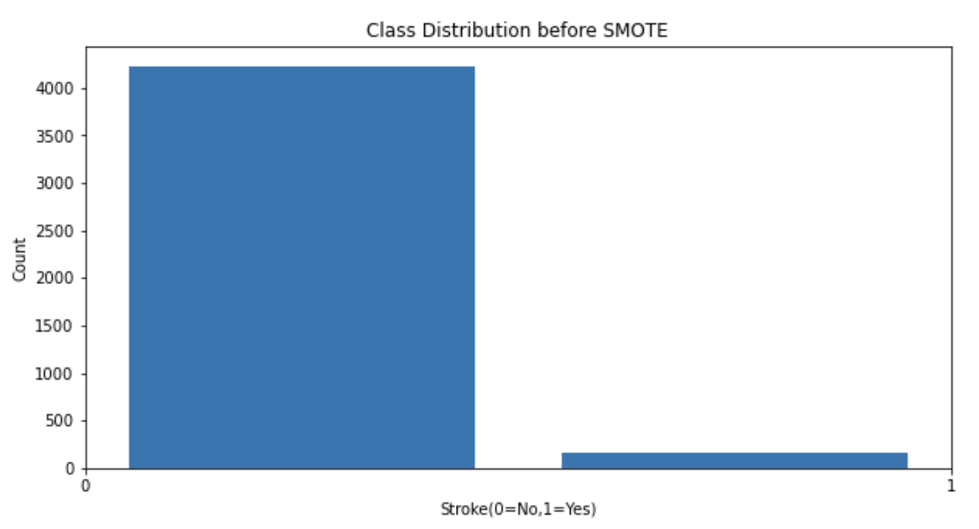
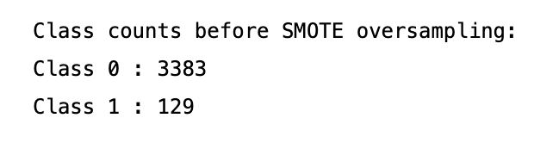
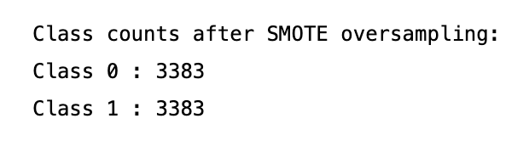
Before and After SMOTE

Slide 9
Models

Slide 10
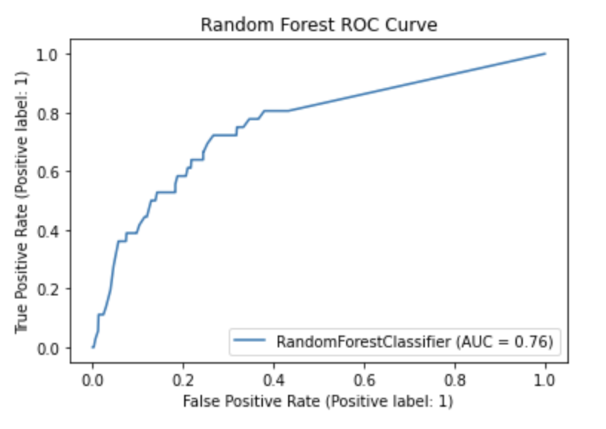
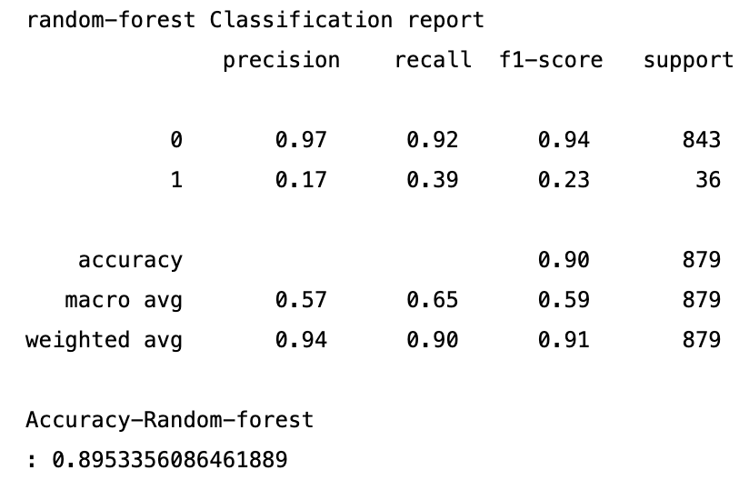
Random Forest

Slide 11
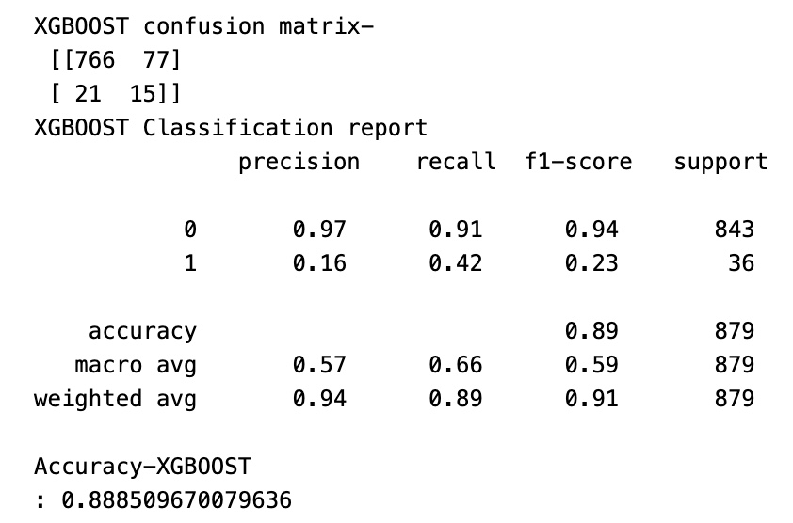
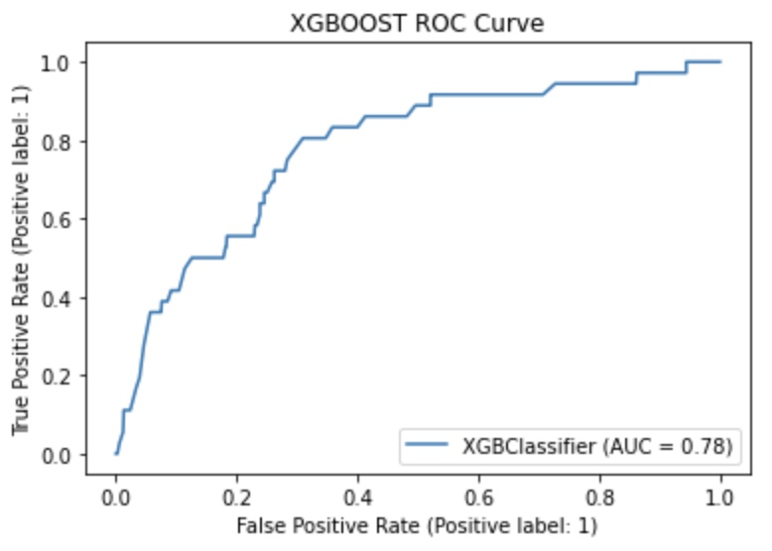
XGBoost

Slide 12
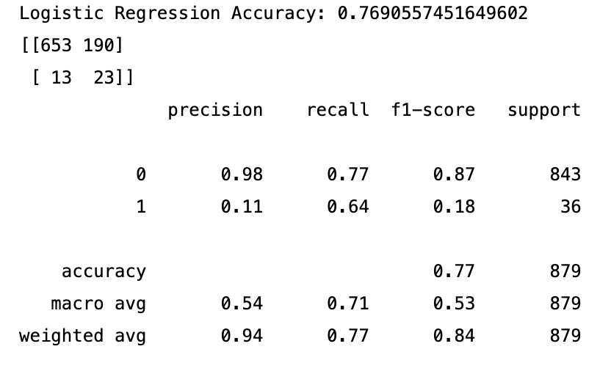
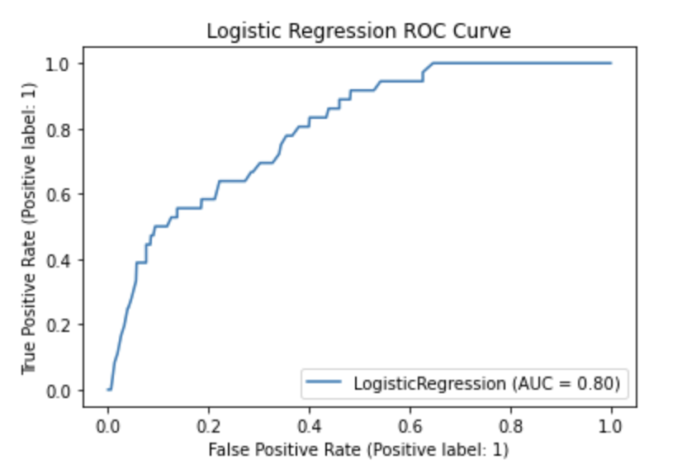
Logistic Regression

Slide 13
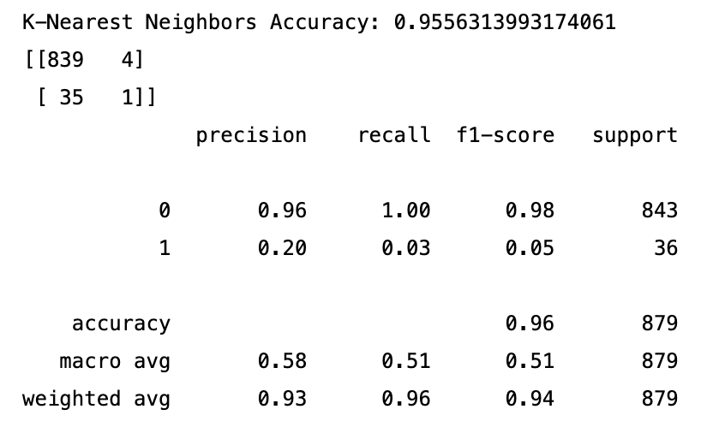
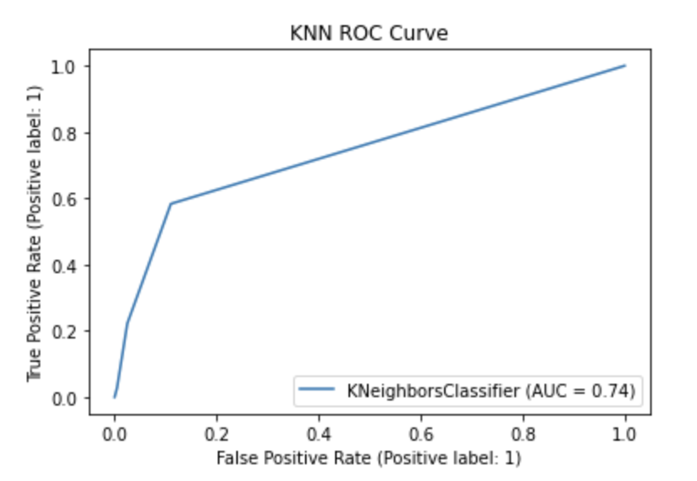
K Nearest Neighbor

Slide 14
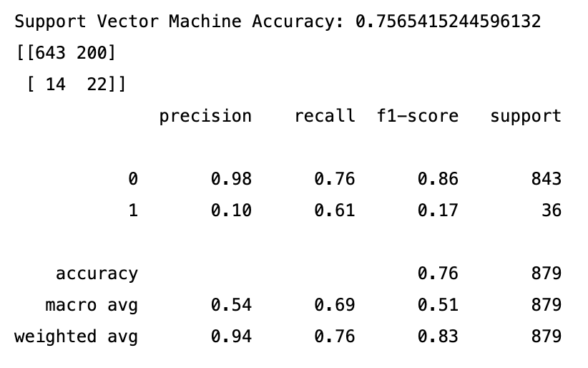
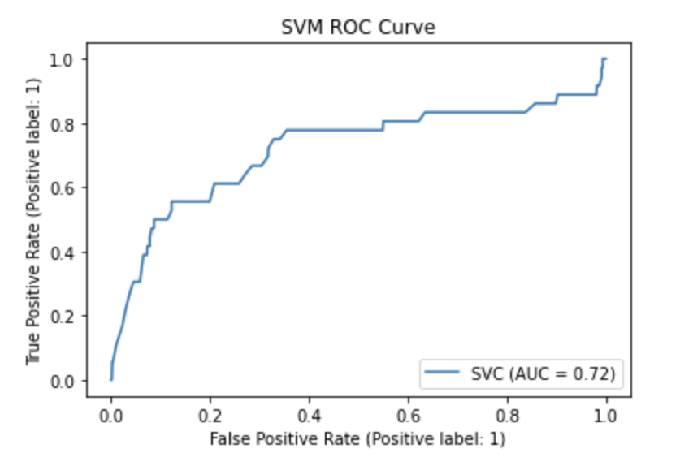
Support Vector Machine

Slide 15
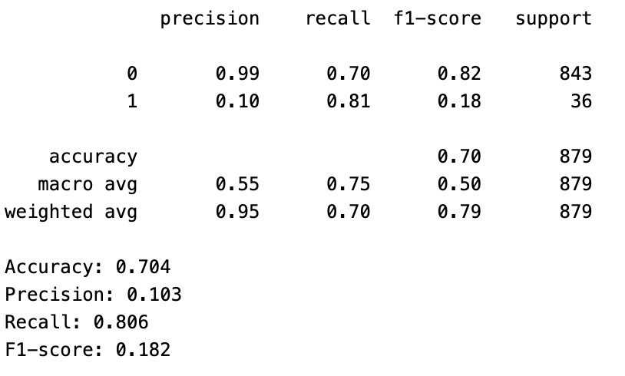
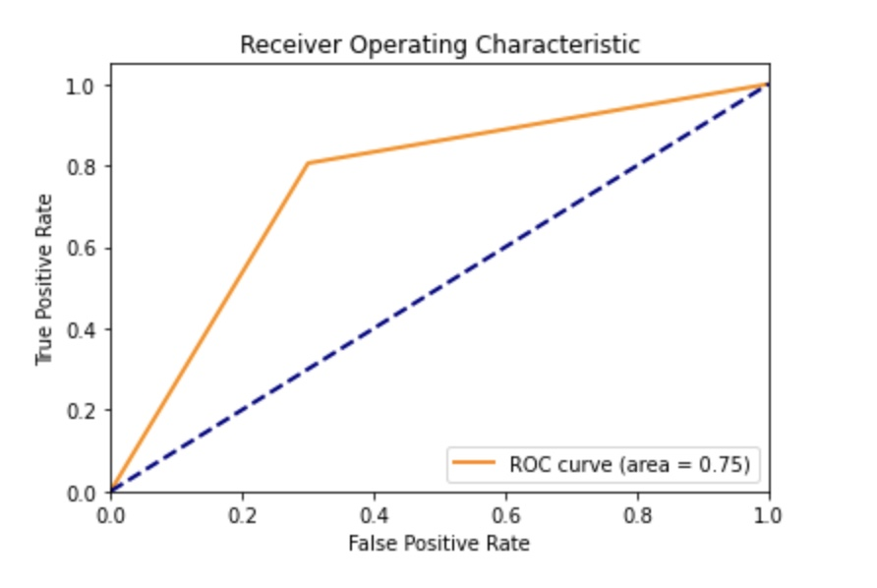
Multi-Layer Perceptron

Slide 16
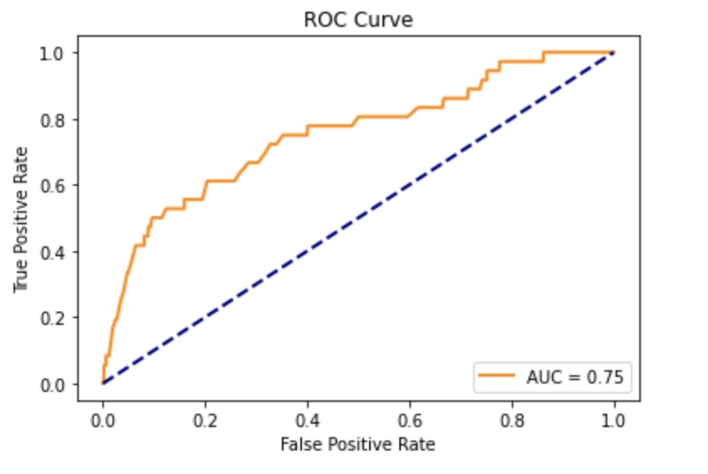
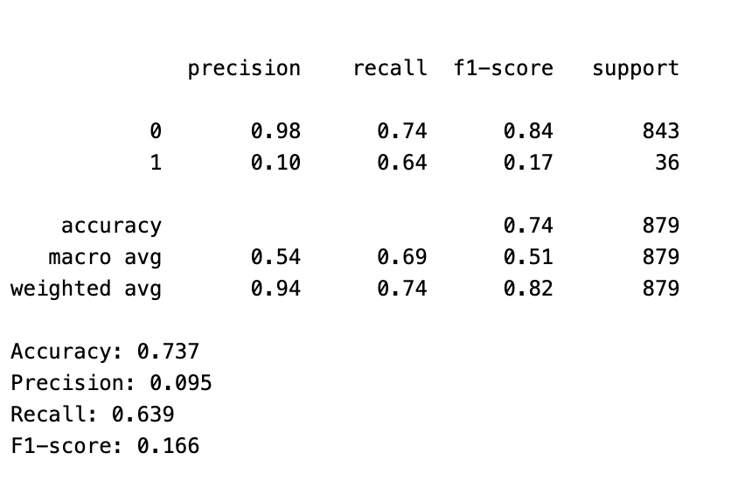
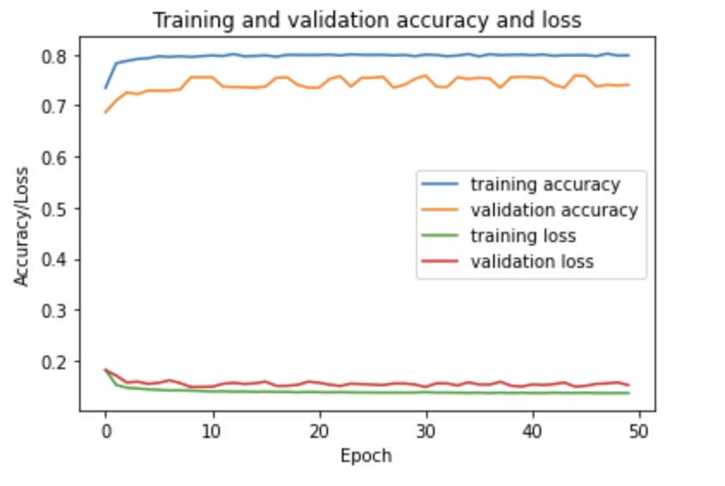
Keras Model

Slide 17
Model Comparison
Model Name | Precision | F1 Score | ROC | Accuracy | Recall
Random Forest | 0.17 | 0.23 | 0.76 | 0.89 | 0.39
XGboost | 0.16 | 0.23 | 0.78 | 0.88 | 0.42
Logistic Regression | 0.11 | 0.18 | 0.80 | 0.77 | 0.64
KNN | 0.20 | 0.05 | 0.74 | 0.95 | 0.03
SVM | 0.10 | 0.17 | 0.72 | 0.75 | 0.61
MLP | 0.10 | 0.18 | 0.75 | 0.70 | 0.81
Keras | 0.09 | 0.16 | 0.75 | 0.74 | 0.61

Slide 18
Conclusion
Based off all the models we have built, we choose MLP to be the best model
This is because MLP has the highest recall score
Since our problem statement deals with stroke prediction, recall is our evaluating metric.

Slide 19
Questions?

Slide 20
Thank you

